Slide 1
Invasion: Code Name X
Group 7 : White midi
Xiong Muxin Xie Shaokang Yang Yixuan
Sustech

Slide 2
CONTENTS
01
Background
02
Gameplay
03
Challenge

Slide 3
PART 01
Background
Some Background of the Game

Slide 4





Originated From…
MOBA
Tower Denfense
Multiplayer online battle arena (MOBA)
is a subgenre of strategy video games in which two teams of players compete against each other on a predefined battlefield.
Tower defense game refers to a type of real-time strategy computer game that builds turrets or similar structures on the map to prevent the enemy from reaching the fortress in the game.

Slide 5
PART 02
Gameplay
Basic rules of our game

Slide 6
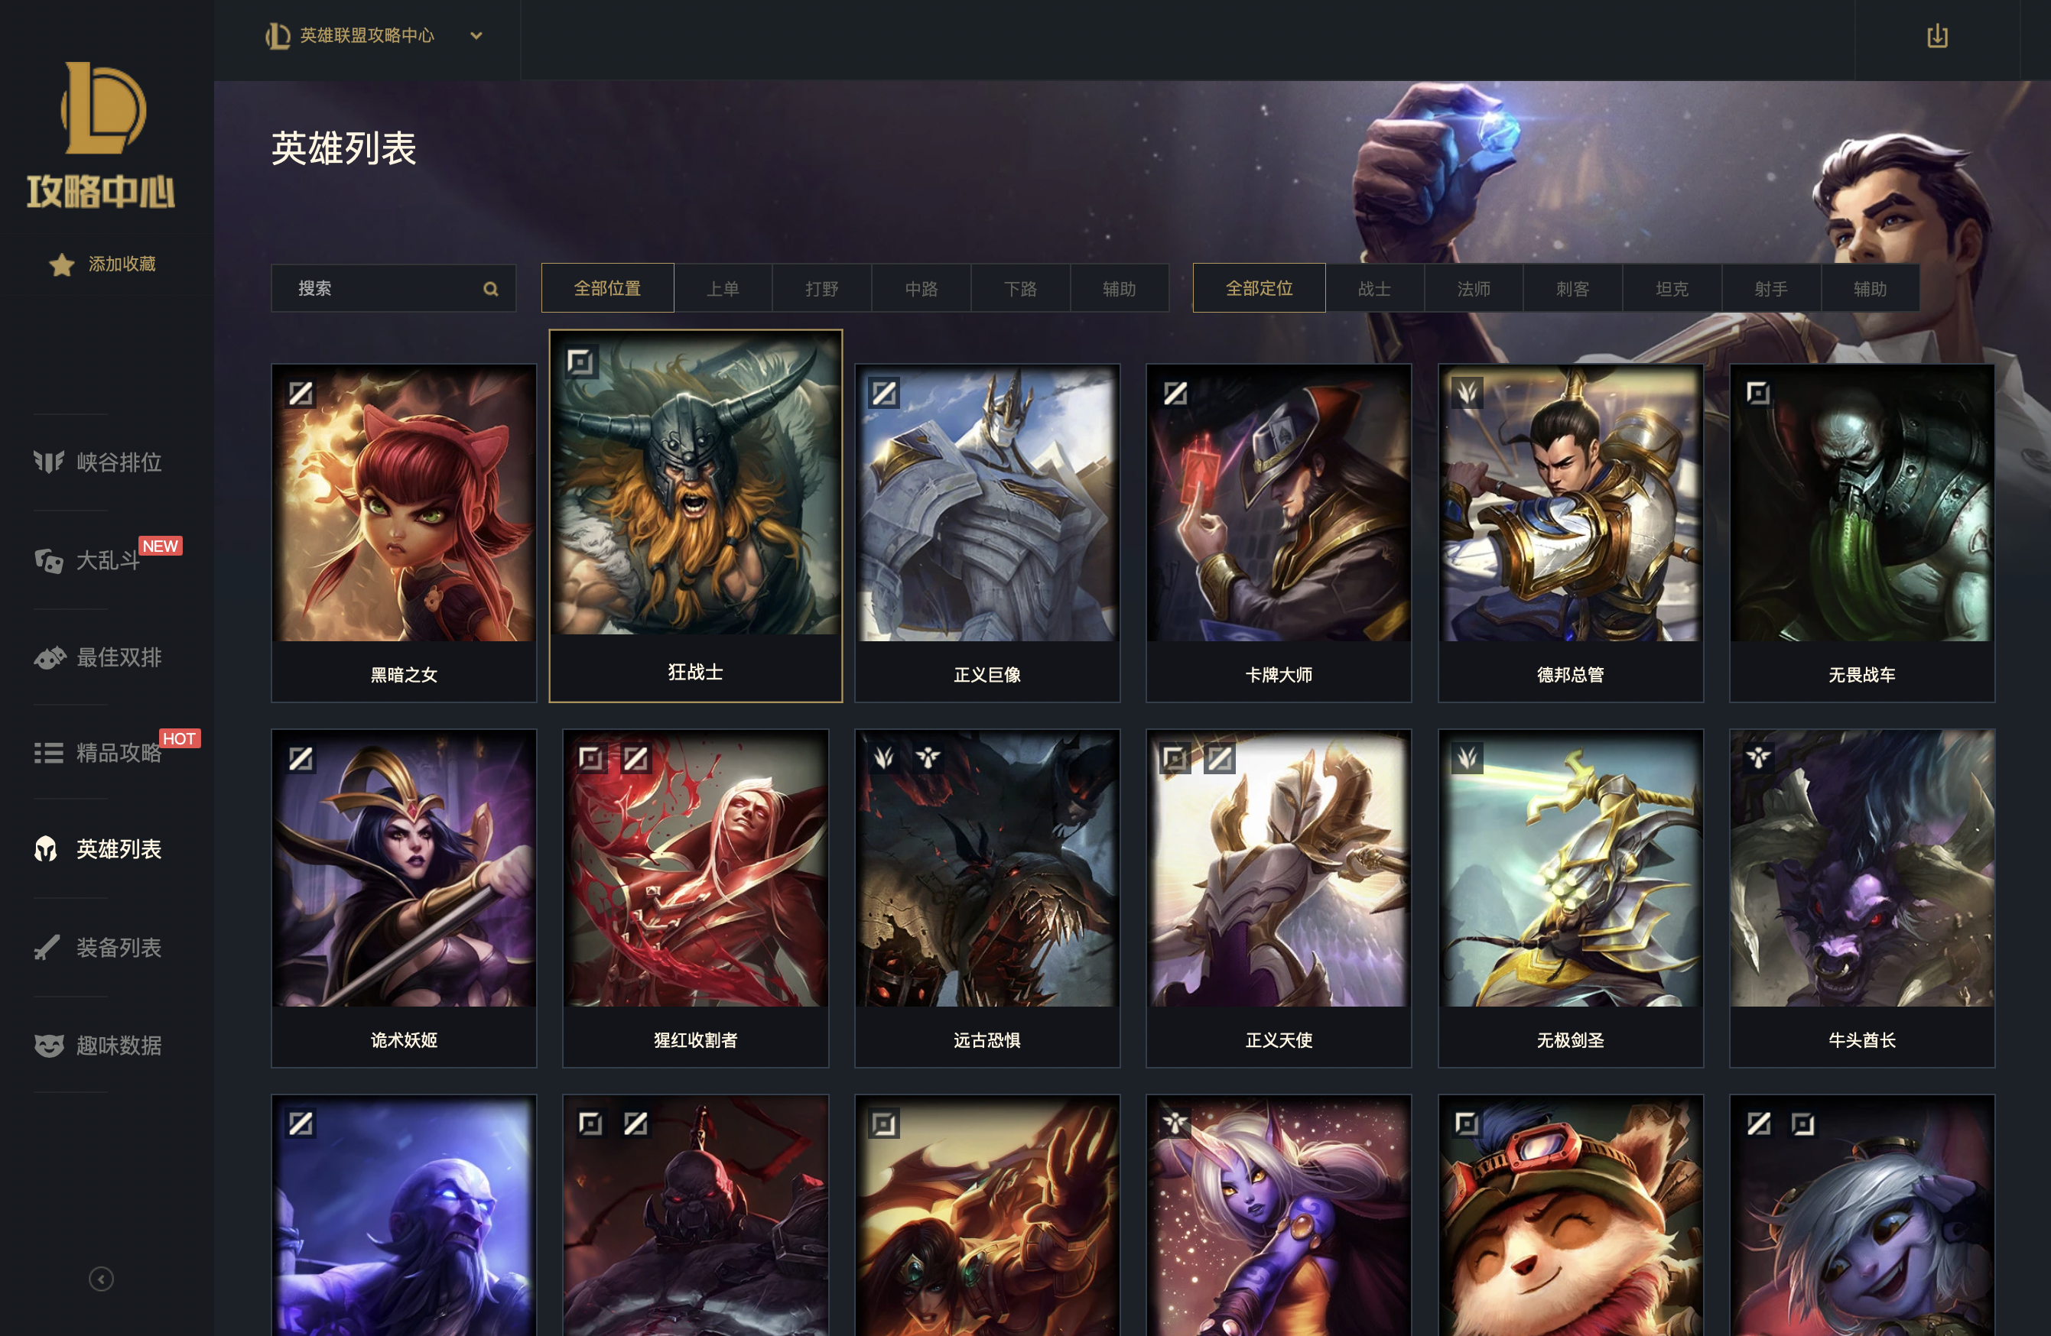
Mix of MOBA(Multiplayer Online Battle Arena) and TD(Tower Defense)

Slide 7
Two players battle
1 vs 1
One road in the map
In both ends of the road, there are two main Crystals which are the base camps of each player. Along the road, there are several small Crystal. Each player should firstly beat all the small Crystals and who beat the opponent’s base camp and then this player win.
Dogface and Skills
Use weapons on the crystal to shoot opponent

Slide 8
PART 03
challenge
Some challenges and difficulties of the game

Slide 9
Difficulties
Technical Challenges In Game
The moving of hero and minion
Huge amont of bugs under free play
A
B
C
D
Multiplayer online game
Balancing among different strategies

Slide 10
Thanks for Listening
Group 7 : White midi

